Slide 1
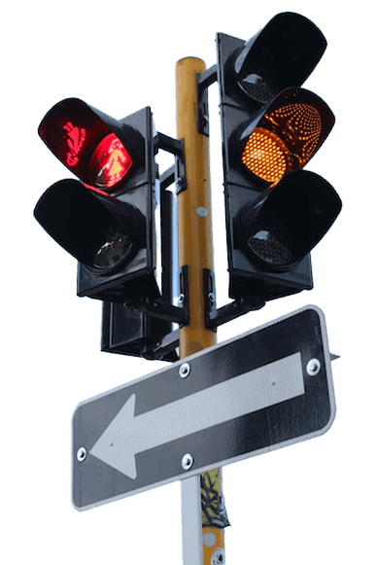
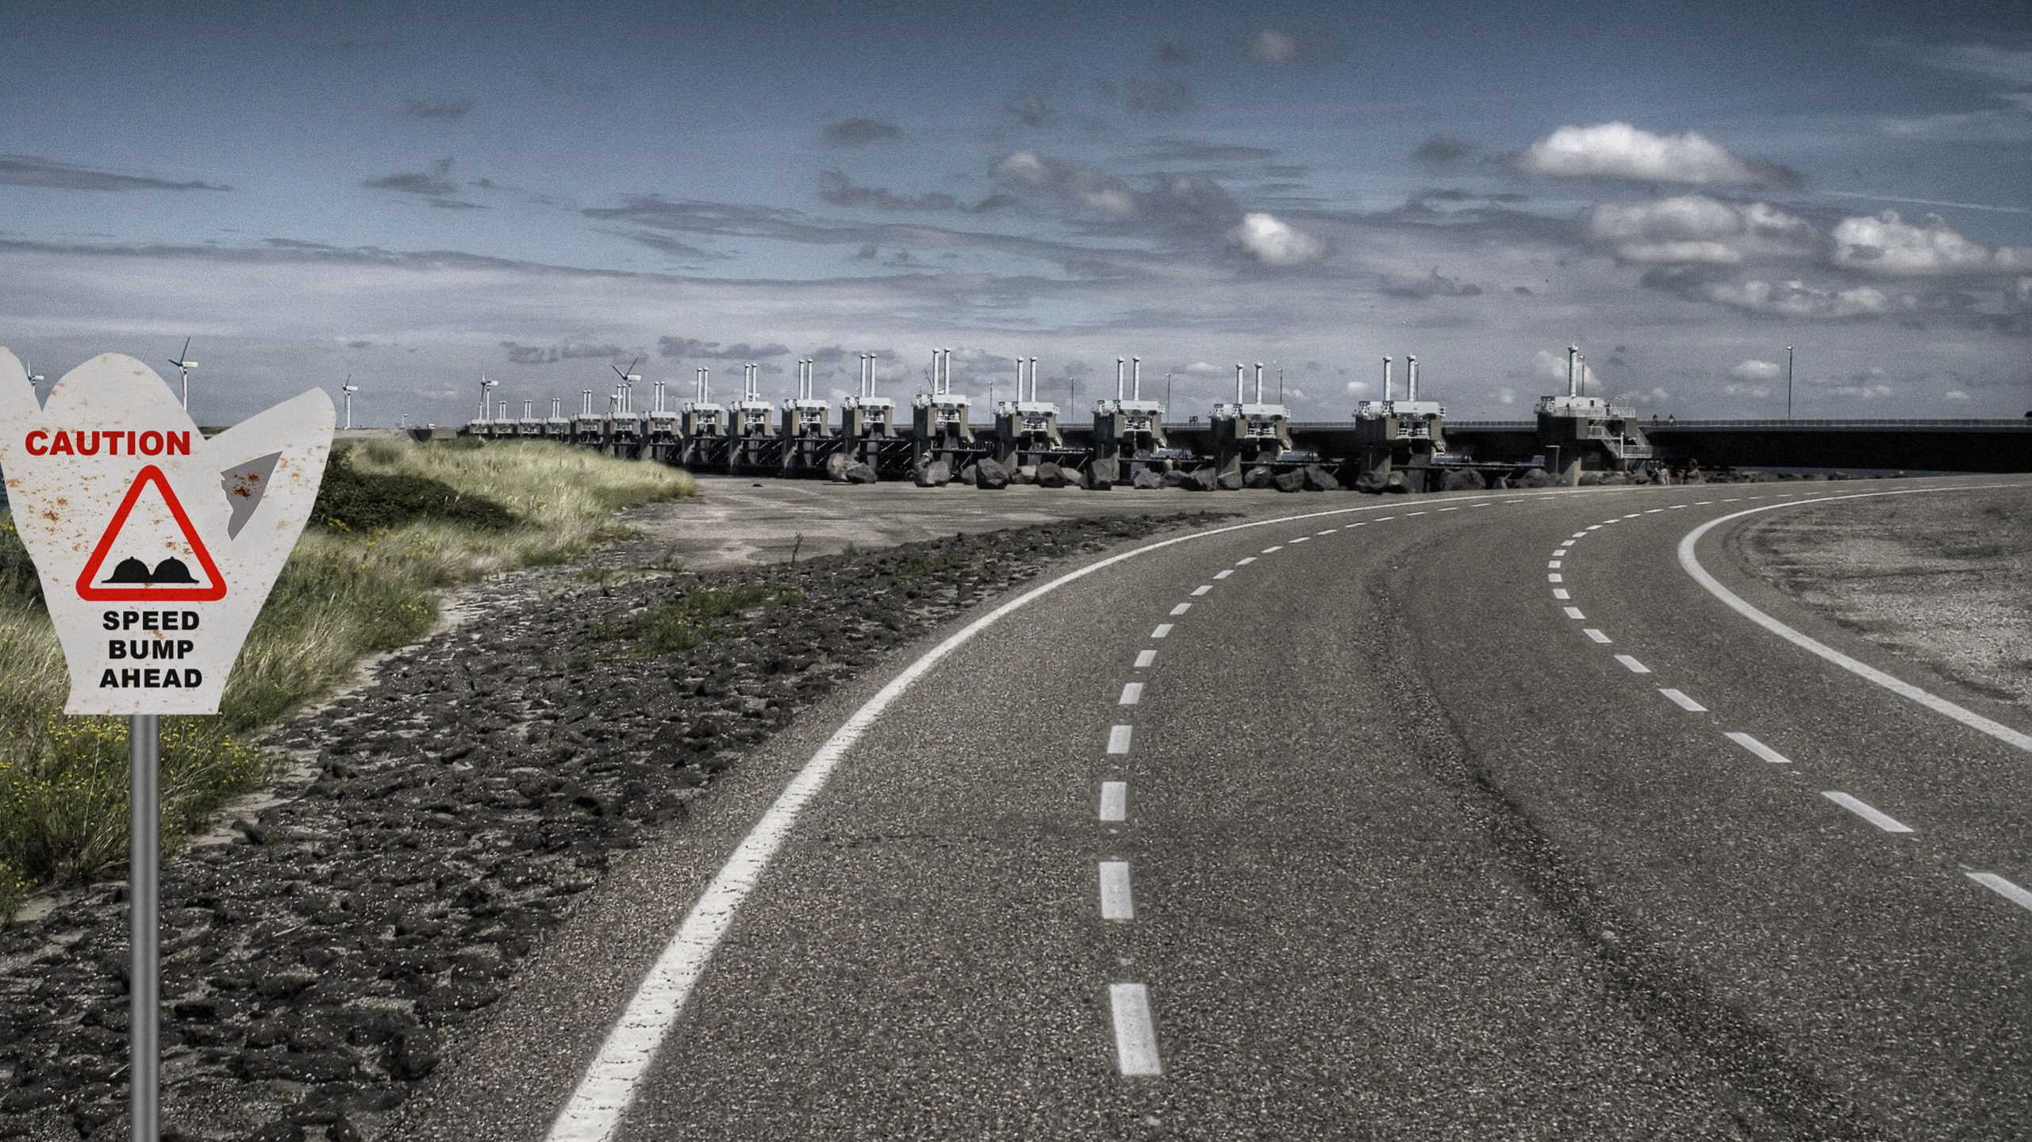
Traffic Sign Recognition System

Slide 2
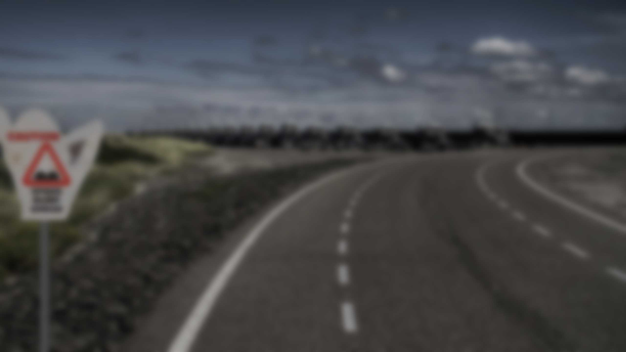


A Project On
Traffic Sign Recognition System Using SVM and KNN Model
Submitted by : Group 9
Dipayan Roy - 01213702021(M1)
Shubham Jangir - 01713702021(M1)
Submitted to –
Mr Prateek Gupta (Data Science Trainer)

Slide 3



Aim/Target of this project
To develop an accurate and efficient Traffic Sign Recognition system using the German Traffic Sign Recognition Benchmark (GTSRB) database.

Slide 4



Aim/Target of this project
To develop an accurate and efficient Traffic Sign Recognition system using the German Traffic Sign Recognition Benchmark (GTSRB) database.
To develop an accurate and efficient Traffic Sign Recognition system using the German Traffic Sign Recognition Benchmark (GTSRB) database.
Objectives
The main objective of the Traffic Sign recognition project is to identify a traffic sign from a given image
The sign image may be present from various angles and in many diverse background situations.
Traffic sign Image will then be sent to model for recognition and will return its prediction

Slide 5


Objective
Develop a Traffic Sign Recognition application.
Employ image processing techniques to preprocess and analyze uploaded images.
Implement a machine learning model (SUPPORT VECTOR MACHINE) for traffic sign classification.
Load a pre-trained SVM model to predict the traffic sign's identity.
Display the predicted sign's name and relevant information to the user.
Provide a graphical user interface (GUI) for user interaction.
Allow users to upload images of traffic signs for recognition.

Slide 6

For This Project We Used
Python 3.11.4
GTSRB Dataset from Kaggle
Knn model
Svm model
Libraries-
os
Pandas
Numpy
Skimage
Sklearn
Joblib

Slide 7



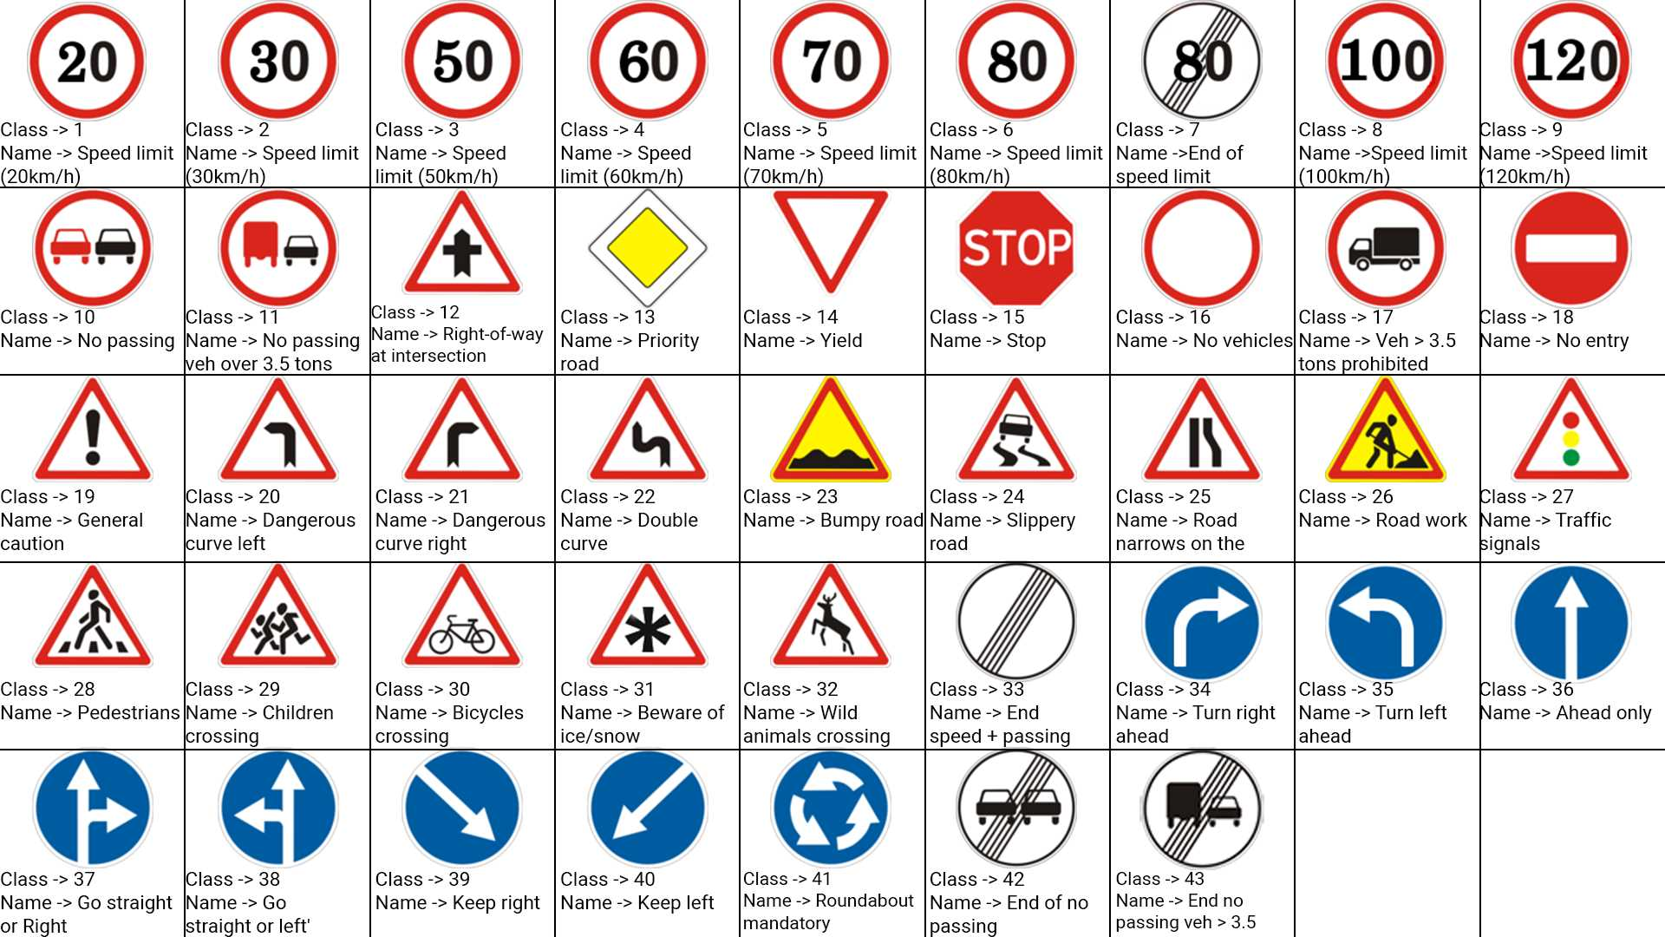
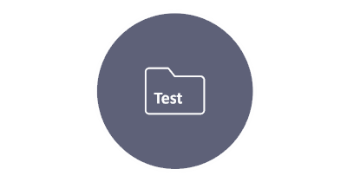

Notes:
https://unsplash.com/photos/AXu2aZ3YgP8

Slide 8

GTSRB Dataset

Slide 9




GTSRB Dataset
The German Traffic Sign Benchmark from Kaggle is a multi-class, single-image classification challenge held at the International Joint Conference on Neural Networks (IJCNN) 2011.
It has the following properties:
Single-image, multi-class classification problem
More than 40 classes
More than 50,000 images in total
Large, lifelike database

Slide 10

Dashboard

Slide 11

GTSRB DATASET
Meta
Train
Test
43 classes/Folders
43 Images
12,631 images
39,209 images

Slide 12
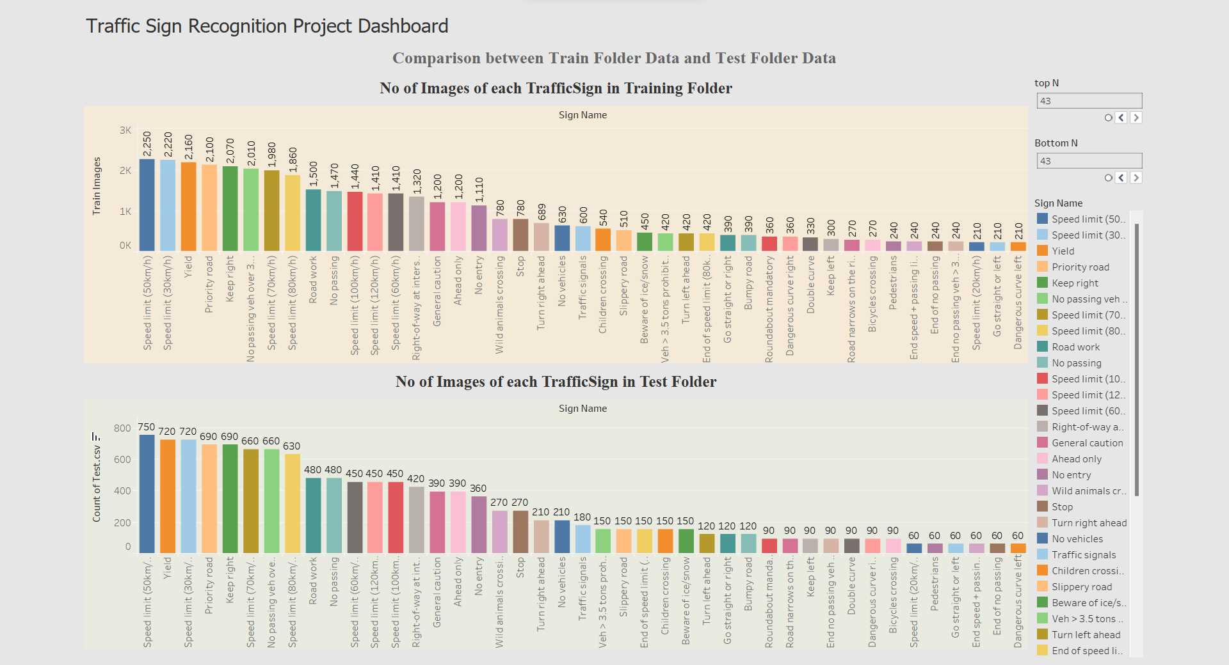

Slide 13

Meta

Slide 14


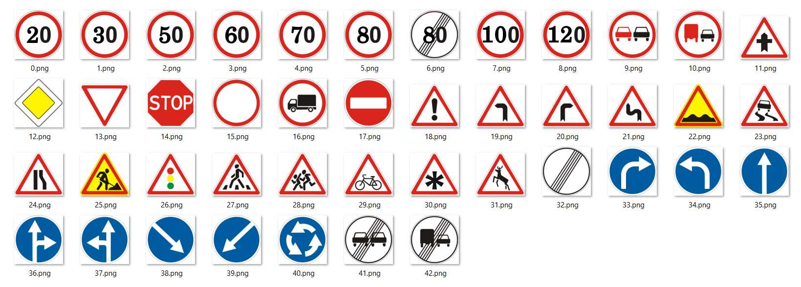
Meta Files
Meta
The Meta Folder Contains images of all the 43 Images that are named as per their class id.

Slide 15
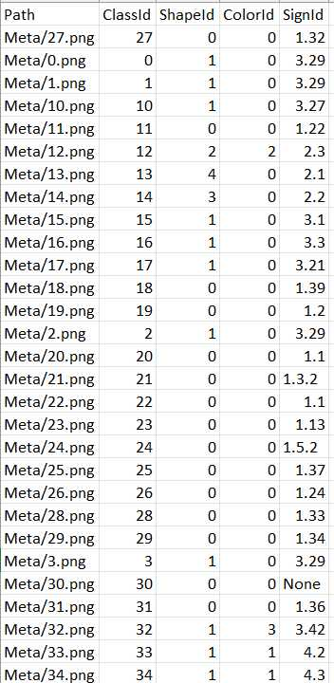
Meta CSV
Meta
The Meta csv contains :
path to image in meta folder
class id
shape id
colour id and
Sign id

Slide 16
Train

Slide 17

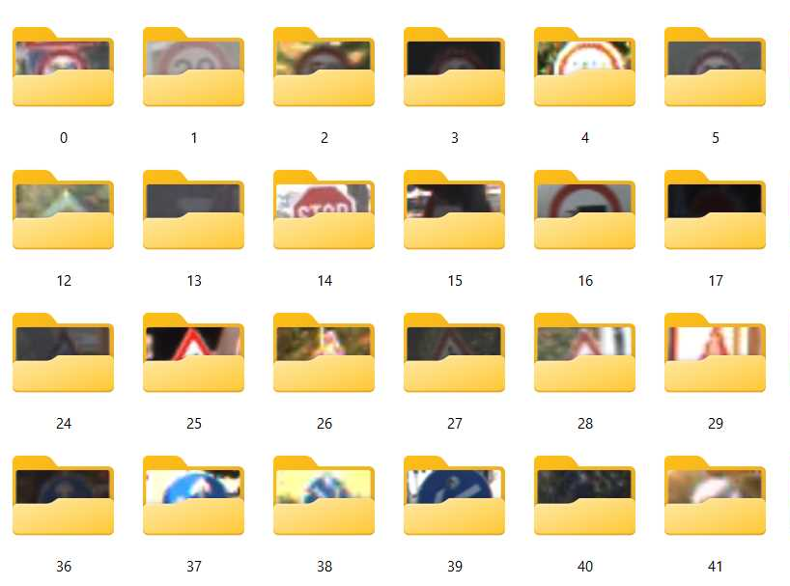
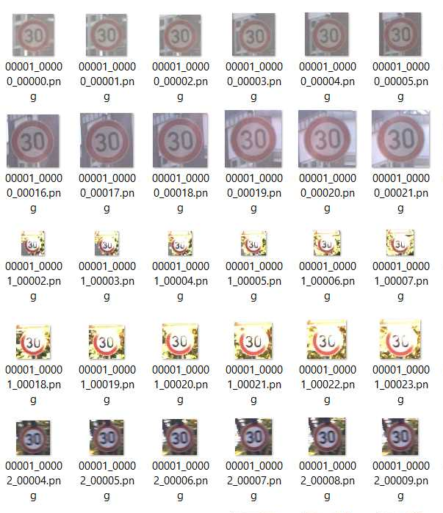
Training Files
Train
The Train Folder Contains all the images for model Training in 43 sub folders which contains images of Traffic Signs in different size ,location,angle and lighting conditions

Slide 18


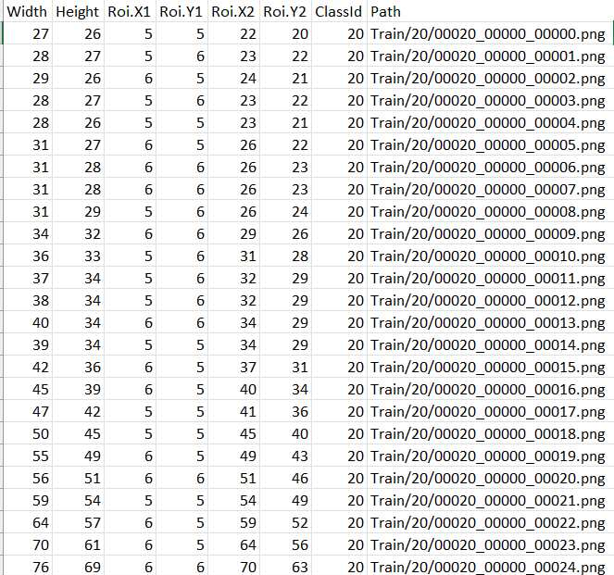
Train CSV
Train
The Train csv contains:
Width
Height
class Id
Region of Interest
path to the image in train folder

Slide 19
Test

Slide 20


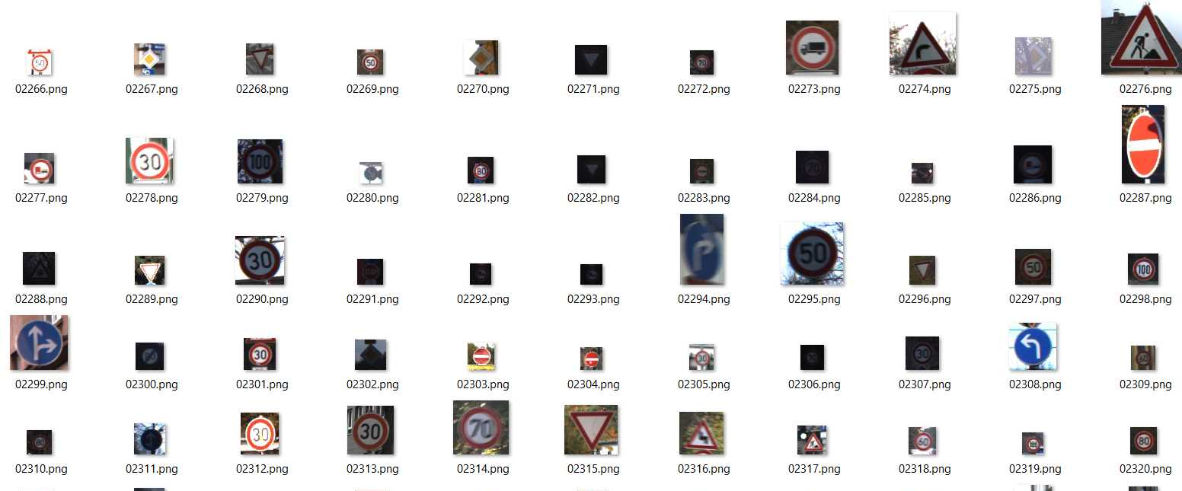
Testing Files
Test
The Test folder contains multiple random images from the train folder for testing purposes

Slide 21


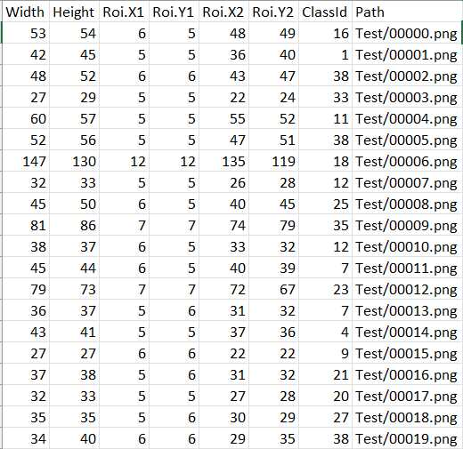
Test CSV
Test
The Test csv contains :
Width
Height
class Id
Region of Interest
path to image in test folder

Slide 22
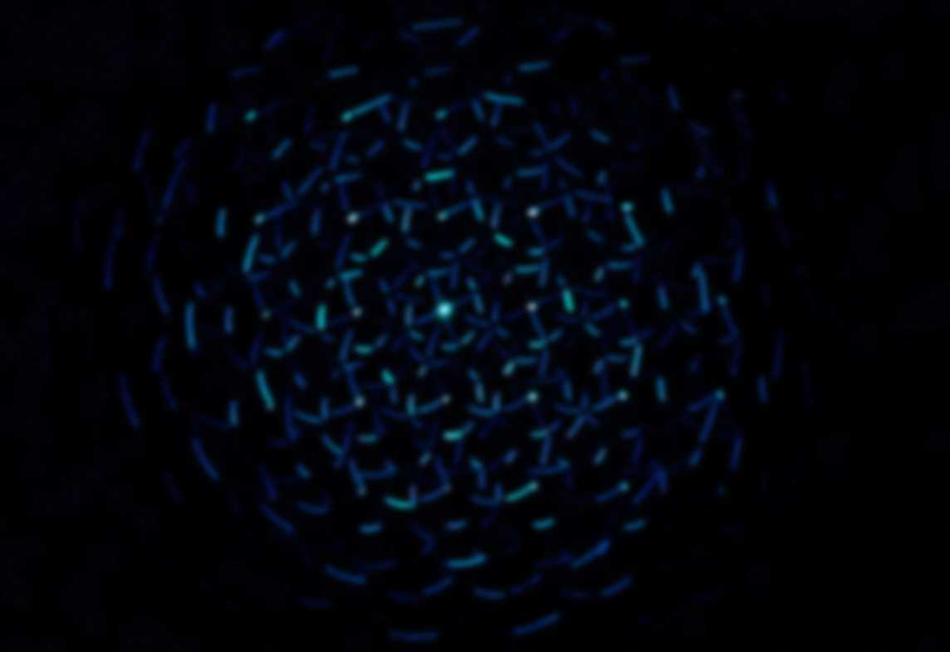
Models Used
Feature | K-Nearest Neighbors (KNN) | Support Vector Machine (SVM)
Type | Supervised learning algorithm used for classification and regression. | Supervised learning algorithm primarily used for classification tasks.
Working Principle | Assigns a class label based on the majority class among the k-nearest neighbors in the feature space. | Finds a hyperplane that best separates classes in the feature space, aiming to maximize the margin between classes.
Training | Memorizes the entire training dataset. | Constructs a decision boundary based on support vectors (data points close to the decision boundary).
Distance Metric | Typically uses Euclidean distance to measure the proximity between data points. | Focuses on maximizing the margin between classes and may use various kernels to transform data into higher-dimensional space.
Parameter Tuning | Requires selecting the number of neighbors (k) and a suitable distance metric. | Involves tuning parameters like C (trade-off between training error and margin) and kernel parameters (if using a kernel).

Slide 23
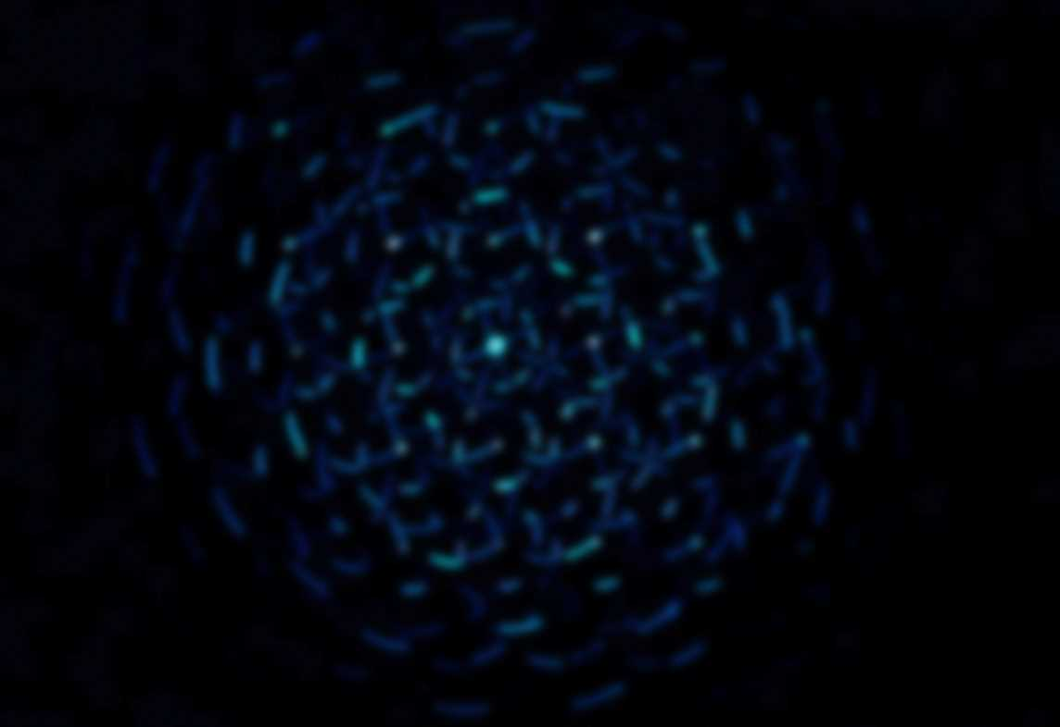
Why choose SVM Model ?
Support Vector Machine (SVM) is chosen for various reasons depending on the characteristics of the problem and the dataset.
Accuracy Difference:
96.73 accuracy in KNN ,while 96.63 accuracy in SVM
Imbalanced Classes:
Traffic sign datasets have imbalanced classes where some signs are less frequent. SVM with RBF can handle class imbalances better and provide more robust predictions.
Margin Maximization:
SVM aims to find a decision boundary (hyperplane) that maximizes the margin between classes. This can lead to better generalization and improved performance on new, unseen data.
Large Dataset:
SVM can handle large datasets more efficiently due to its focus on support vectors, which are the key points for determining the hyperplane. kNN can become computationally expensive and memory-intensive with larger datasets.
Clear Decision Boundary:
In cases where a clear separation between classes is possible, SVM can provide a well-defined decision boundary, making the model's predictions more interpretable.

Slide 24
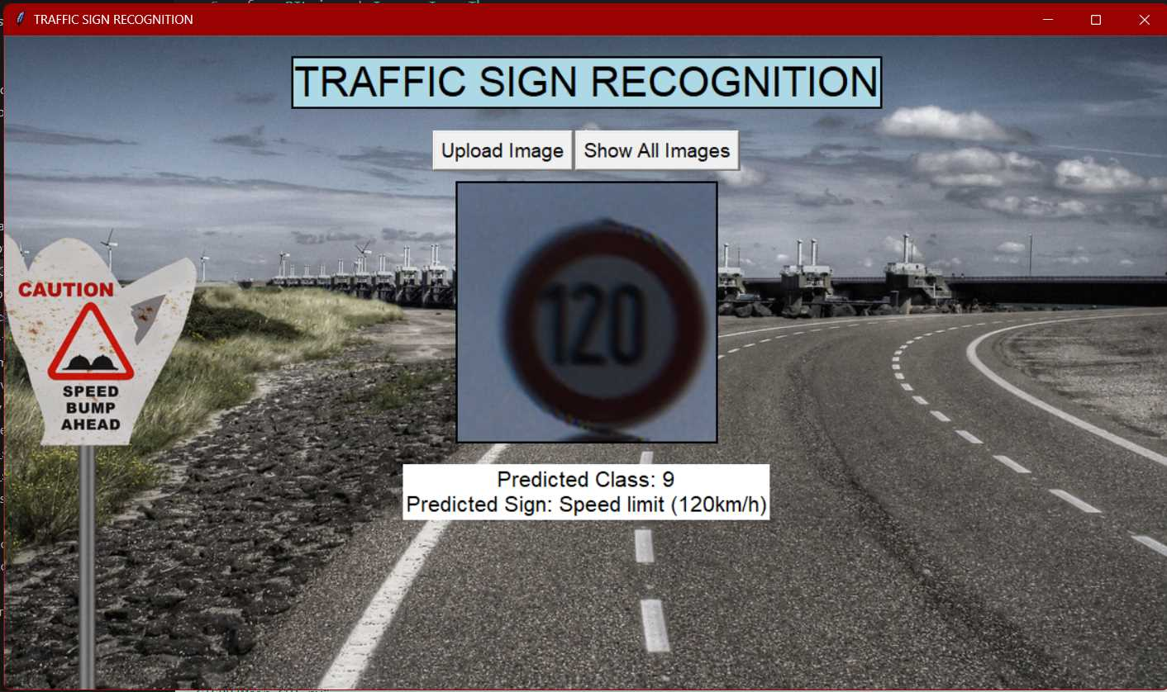
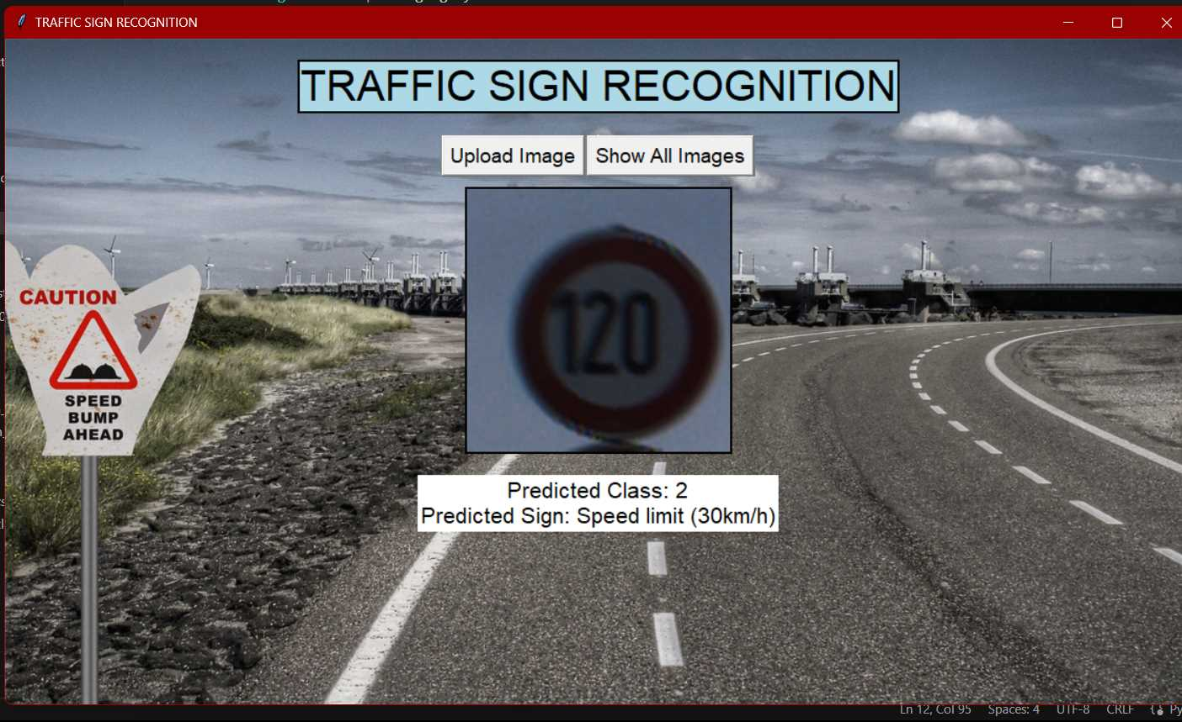
<- KNN Model
SVM
Model ->
SVM
Model ->

Slide 25

Main Code

Slide 26
Libraries imported
import os #To load Files
import pandas as pd #To import csv files for image path and labels
import numpy as np #To create array of Images
from skimage.io import imread #to read images from the path
from skimage.color import rgb2gray #to greyscale images
from skimage.transform import resize #to resize all images to a specific size
from skimage.feature import hog #To extract features from images
from sklearn.model_selection import train_test_split #splitting training & testing data
from sklearn.neighbors import KNeighborsClassifier #KNN Model
from sklearn.svm import SVC #SVM Model
import joblib #to export model to pkl file
from sklearn.metrics import classification_report #for classification report of the model

Slide 27
# Path to the directory containing the GTSRB dataset data_dir = "D:/college files/DS course/trafic recog project code/GTSRB/Train" # Path to the CSV file containing image paths and class IDs csv_file_path = "D:/college files/DS course/trafic recog project code/GTSRB/Train.csv" # Load the CSV file into a DataFrame data_df = pd.read_csv(csv_file_path)
Loading csv file

Slide 28
Loading images and labels
# Initialize empty lists to store data and labels
data = []
labels = []
# Load images and labels from the CSV file
for _, row in data_df.iterrows():
image_path = os.path.join(data_dir, row['Path'][6:]) # Remove "Train/" from the path
image = imread(image_path)
image_gray = rgb2gray(image)
image_resized = resize(image_gray, (32, 32))
data.append(image_resized)
labels.append(row['ClassId'])
# Convert lists to numpy arrays
data = np.array(data)
labels = np.array(labels)

Slide 29
Extracting features from images
# Feature extraction using HOG
def extract_hog_features(images):
hog_features = []
for image in images:
features = hog(image, block_norm='L2-Hys', pixels_per_cell=(8, 8), cells_per_block=(2, 2))
hog_features.append(features)
return np.array(hog_features)
X_features = extract_hog_features(data)

Slide 30
Splitting data into train and test
# Split dataset into training and testing subsets
X_train, X_test, y_train,y_test=train_test_split(X_features, labels, test_size=0.30, random_state=42)

Slide 31
Knn model training ,evaluation and saving
# Initialize k-NN model
knn_model = KNeighborsClassifier(n_neighbors=1) # Choose k value
# Train the k-NN model
knn_model.fit(X_train, y_train)
# Evaluate k-NN model accuracy
knn_accuracy = knn_model.score(X_test, y_test)
print("k-NN Model Accuracy:", knn_accuracy)
# Save the trained k-NN model to a file
knn_model_file_path = "D:/college files/DS course/trafic recog project code/GTSRB/traffic_sign_knn_model.pkl"
joblib.dump(knn_model, knn_model_file_path)
y_pred = knn_model.predict(X_test)
class_report = classification_report(y_test, y_pred)
print("Classification Report:\n", class_report)

Slide 32
SVM model training ,evaluation and saving
# Initialize SVM model
svm_model = SVC(kernel='rbf', C=10) # Linear kernel, adjust C value if needed
# Train the SVM model
svm_model.fit(X_train, y_train)
# Evaluate SVM model accuracy
svm_accuracy = svm_model.score(X_test, y_test)
print("SVM Model Accuracy:", svm_accuracy)
# Save the trained SVM model to a file
svm_model_file_path = "D:/college files/DS course/trafic recog project code/GTSRB/traffic_sign_svm_model.pkl"
joblib.dump(svm_model, svm_model_file_path)
y_pred = svm_model.predict(X_test)
class_report = classification_report(y_test, y_pred)
print("Classification Report:\n", class_report)

Slide 33

GUI Code

Slide 34
GUI
Importing Libraries and The Trained model
import numpy as np #to save test image feature in array
import tkinter as tk #To create GUI
from tkinter import filedialog #To open file browser
from PIL import Image, ImageTk #To open image from path
from skimage.feature import hog #To extract features from test image
from skimage.color import rgb2gray #To greyscale image
from skimage.transform import resize #To resize image
import joblib #To open saved model
# Load the trained KNN/SVM model
model_file_path = "D:/college files/DS course/trafic recog project code/GTSRB/traffic_sign_svm_model.pkl"
knn_model = joblib.load(model_file_path)

Slide 35
Making sign name dictionary
sign_names = {
0: 'Speed limit (20km/h)',1: 'Speed limit (30km/h)', 2: 'Speed limit (50km/h)',3: 'Speed limit (60km/h)', 4: 'Speed limit (70km/h)', 5: 'Speed limit (80km/h)', 6: 'End of speed limit (80km/h)', 7: 'Speed limit (100km/h)', 8: 'Speed limit (120km/h)', 9: 'No passing', 10: 'No passing veh over 3.5 tons', 11: 'Right-of-way at intersection', 12: 'Priority road', 13: 'Yield', 14: 'Stop', 15: 'No vehicles', 16: 'Veh > 3.5 tons prohibited', 17: 'No entry', 18: 'General caution', 19: 'Dangerous curve left', 20: 'Dangerous curve right', 21: 'Double curve', 22: 'Bumpy road', 23: 'Slippery road', 24: 'Road narrows on the right', 25: 'Road work', 26: 'Traffic signals', 27: 'Pedestrians', 28: 'Children crossing', 29: 'Bicycles crossing', 30: 'Beware of ice/snow', 31: 'Wild animals crossing', 32: 'End speed + passing limits', 33: 'Turn right ahead', 34: 'Turn left ahead', 35: 'Ahead only', 36: 'Go straight or right', 37: 'Go straight or left', 38: 'Keep right', 39: 'Keep left', 40: 'Roundabout mandatory', 41: 'End of no passing', 42: 'End no passing veh > 3.5 tons'
}

Slide 36
Function to open test image
def select_image(self):
file_path = filedialog.askopenfilename(filetypes=[("Image files", "*.png *.jpg *.jpeg *.bmp *.gif")])
if file_path:
self.predict_traffic_sign(file_path)

Slide 37
Prediction function main
def predict_traffic_sign(self, image_path): #Main Prediction Function
image = Image.open(image_path)
image.thumbnail((300, 300))
resized_image = image.resize((250, 250), Image.LANCZOS)# Resize the image to a fixed size
image_tk = ImageTk.PhotoImage(resized_image)
self.label_image.config(image=image_tk)
self.label_image.image = image_tk
predicted_label, predicted_sign_name = self.predict1(image_path)
result_text = f"Predicted Class: {predicted_label+1}\nPredicted Sign: {predicted_sign_name}"
self.label_result.config(text=result_text)

Slide 38
Prediction function 2
def predict1(self, image_path): #Prediction Function
image = Image.open(image_path)
image_gray = rgb2gray(np.array(image))
image_resized = resize(image_gray, (32, 32))
# Extract HOG features
features = hog(image_resized, block_norm='L2-Hys', pixels_per_cell=(8, 8), cells_per_block=(2, 2))
# Predict using the trained KNN model
predicted_label = knn_model.predict([features])[0]
predicted_sign_name = sign_names.get(predicted_label, "Unknown")
return predicted_label, predicted_sign_name

Slide 39
Function for show all button
def show_all_images(self):
image_path = "D:/college files/DS course/trafic recog project code/GTSRB/MetaImage1080.jpg" # Provide the actual path to the meta image
self.display_image_in_new_window(image_path)
def display_image_in_new_window(self, image_path):
new_window = tk.Toplevel(self.root)
new_window.title("Showing All Images")
image = Image.open(image_path)
resized_image = image.resize((1128, 634), Image.LANCZOS) # Resize the image to fit the windows
self.image_tk = ImageTk.PhotoImage(resized_image)
label = tk.Label(new_window, image=self.image_tk,bg='black')
label.pack(padx=10, pady=10)

Slide 40
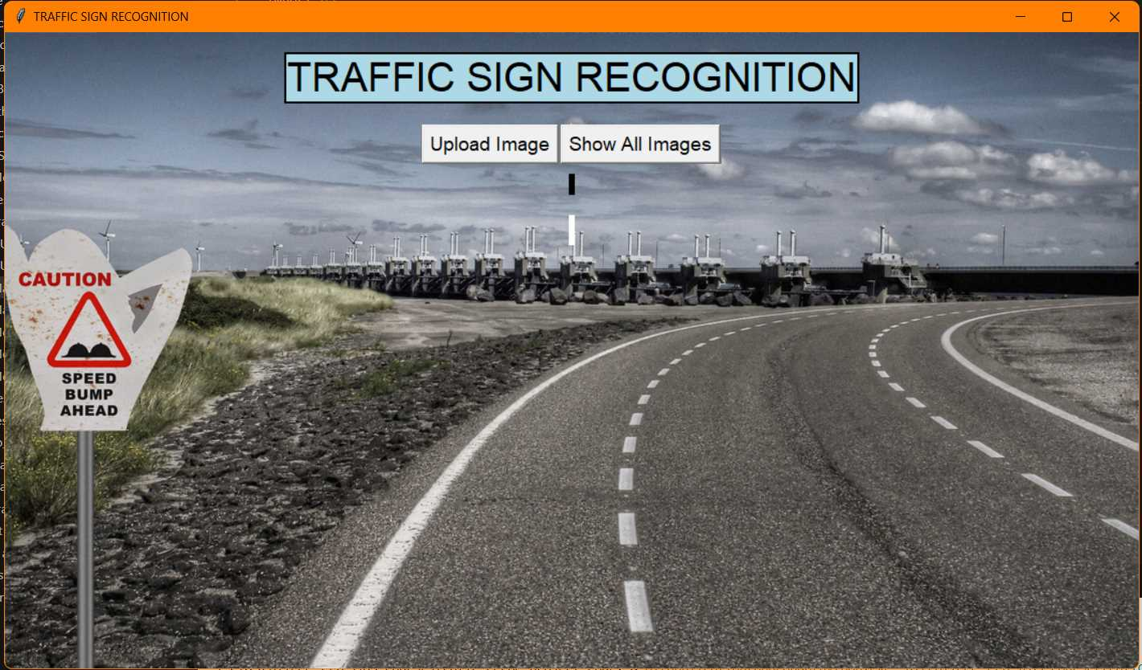
Comparison between different images

Slide 41
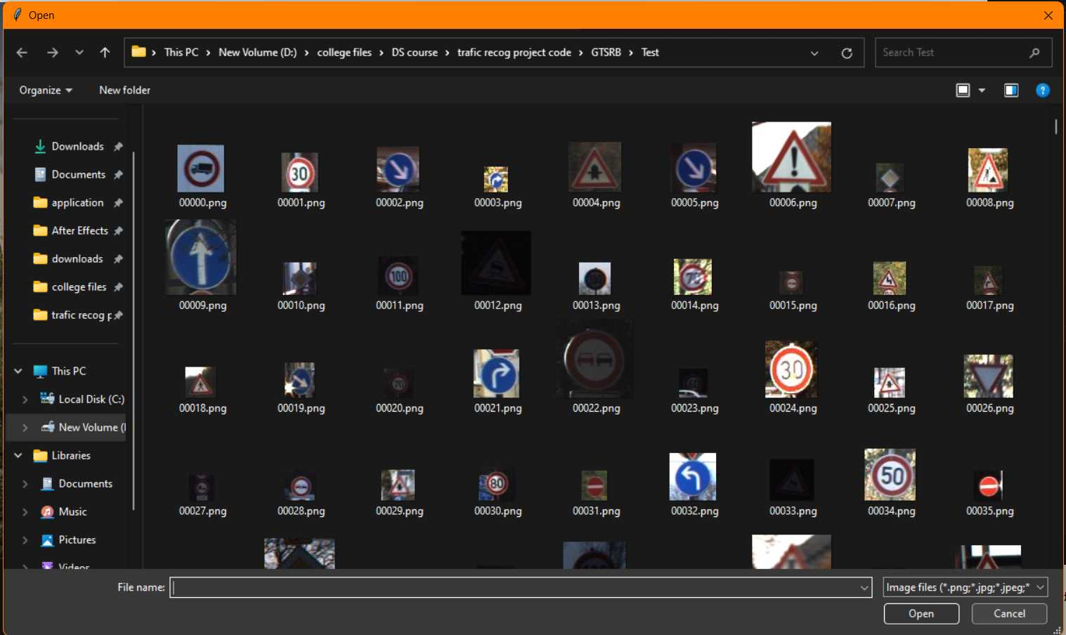
Comparison between different images

Slide 42
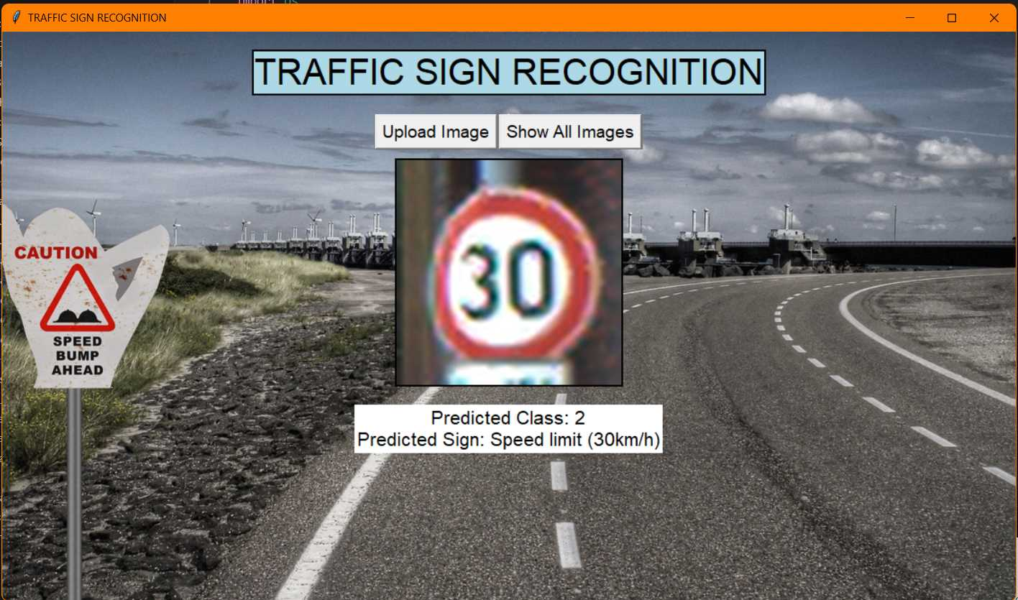
Comparison between different images

Slide 43
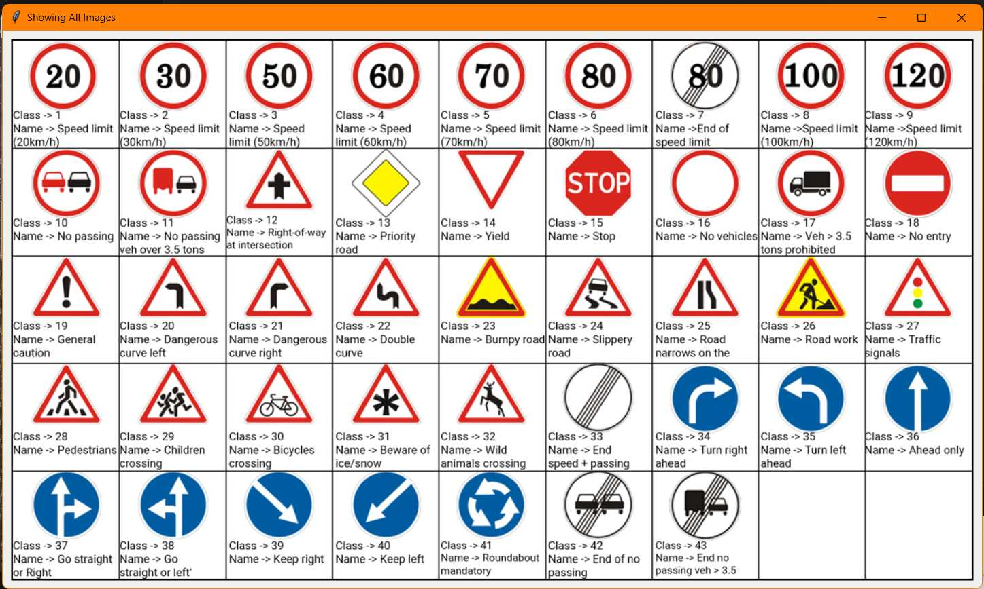
Comparison between different images

Slide 44
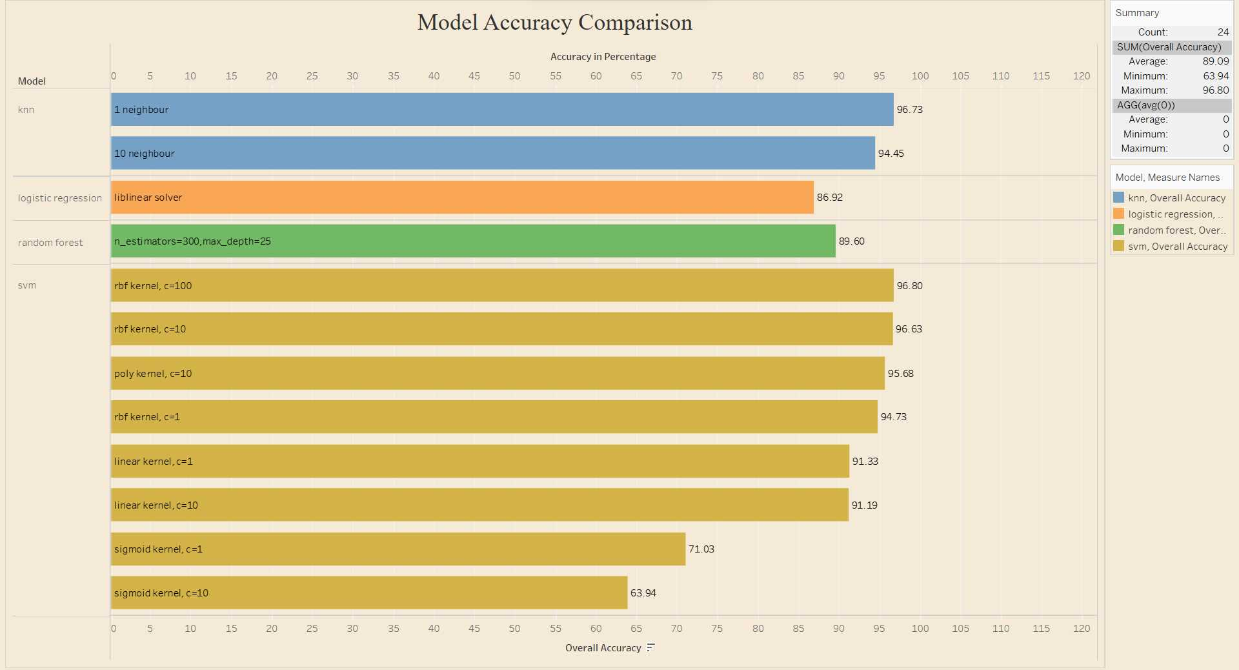

Slide 45
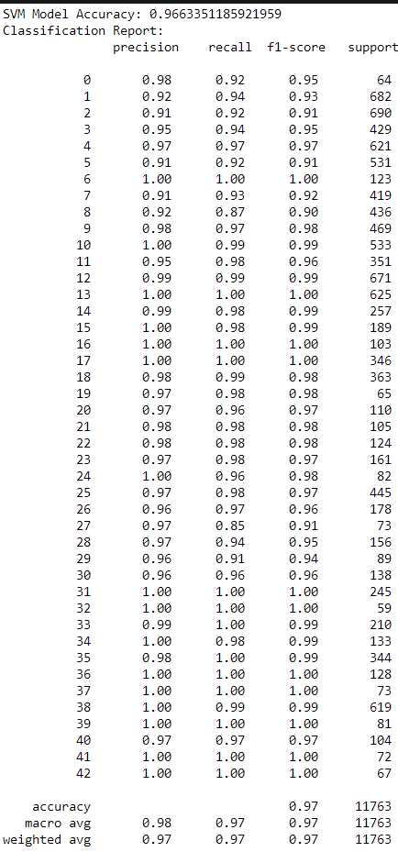
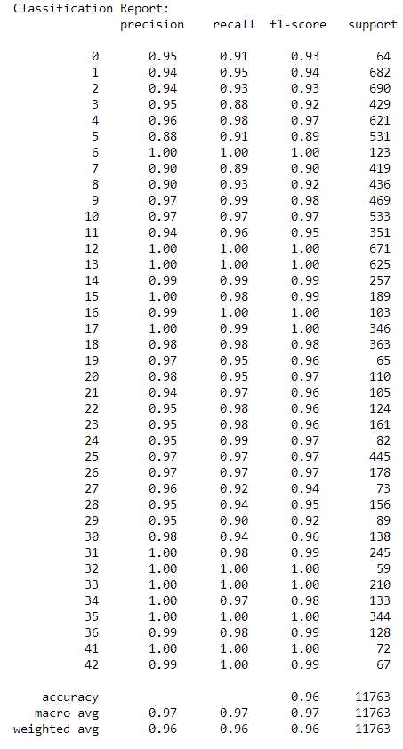
SVM Model ->
Classification
Report
<- KNN Model
Classification
Report

Slide 46
Possible improvements
Allow user to utilize camera directly instead of uploading images
Predict images apart from Testing and Training images.
Improve accuracy to predict more accurately
Add data for more Traffic Signs

Slide 47


Thank Y u

